Slide 1
Factor investing
Some thoughts on the factor investing literature
from the past decade
March 2023

Slide 2
General disclaimers
• When it comes to factor investing, nobody can agree on anything, from
definitions, to how to (best) do it, etc.
• This presentation contains my views.
• Feel free to disagree. Also please present your views at a future meeting.
• Factor investing is a hot topic, and everybody would like to hear your views!
• Reducing 10 years of research into a couple of slides inevitably loses a lot of
nuance and subtlety and leaves a lot out altogether.
• Presentations like this are often prefaced with a disclaimer that it isn’t
investment advice. There’s no such disclaimer here!
2

Slide 3


A note on terminology
• In most of the literature [typically, nobody can agree on anything]:
“Factors” = “anomalies” = “smart beta” = “style investing”
• Basilico and Johnsen (2019): “We will use terms like smart beta, strategic beta, risk
premia investing, style investing and factor investing interchangeably.”
• This presentation sticks with “factors” and “factor investing”.
• If this presentation wants to quote a paper that says:
“Smart beta investing is great”
This quote will appear in this presentation as:
“[Factor] investing is great”
• Note: Basically all the research mentioned here is based on the US market.
3

Slide 4
Overview of talk
❑ Reminder: Beating the market (long-term, consistently) is hard.
❑ Factors and factor investing. Long-short vs. long-only.
❑ Beware of the transaction costs.
❑ Identifying factors. Data mining (p-hacking).
❑ Constructing factor models. Model mining.
❑ Machine learning (ML) is not helping, despite the hype.
❑ Factor timing. Predicting the future, and all that.
❑ Factor performance: Past is not prologue.
❑ How to profit reliably from factor investing.
❑ Reminder: Beating the market is hard.
4

Slide 5

Reminder: Beating the market is hard
• Cochrane (1999):
• “I emphasize a cautionary fact: The average investor must hold the market.”
• “You should only vary from a passive market index if you are different from
everyone else.”
• “It cannot be the case that every investor should tilt his portfolio toward value or
other high-yield strategies. If everybody did it, the phenomenon would disappear.”
• Melas (2016):
• “In reality, market-cap benchmarks are extremely difficult to outperform
consistently.”
• White and Haghani (2020):
• “For factors with plausible risk-based explanations, the authors conclude that even in
the presence of significant factor premia, the market portfolio is still likely to be
optimal for most investors.”
• Nes (2020): Looking at factor investing ETFs over Jan-2007 and Mar-2020.
• “This thesis does not find any statistically significant evidence of [factor] ETFs
outperforming … broad, cap-weighted market indices.”
5

Slide 6
Preview: What a decade it has been
• Stage 1: Promises, promises
• Ang (2014): “…there is a long-run reward for being exposed to factor risk.”
• Amenc et al. (2015): “[Factor investing] strategies are usually marketed on the basis
of outperformance.”
• UBS (2016): “The premise of factor investing… is that stocks with certain
characteristics known as 'factors' outperform the market in the long term.”
• Stage 2: Excitement, hype
• Cerniglia and Fabozzi (2018): “factors have become an increasing fashionable way
to invest assets”
• Dopfel and Lester (2018): “extraordinary growth in the use of [factor investing]
funds by institutional investors, both large and small.”
• Li et al. (2019): “Assets have been flowing steadily from actively managed funds to
factor-investing strategies since about 2008.”
• Stage 3: Disappointments, suspicions, recriminations
• Arnott et al. (2019): “Factor investing has failed to live up to its many promises.”
• Vincent et al. (2018): “Skeptics have stated that the [factor investing] strategies are
merely smart marketing without any value being added for investors.
6

Slide 7
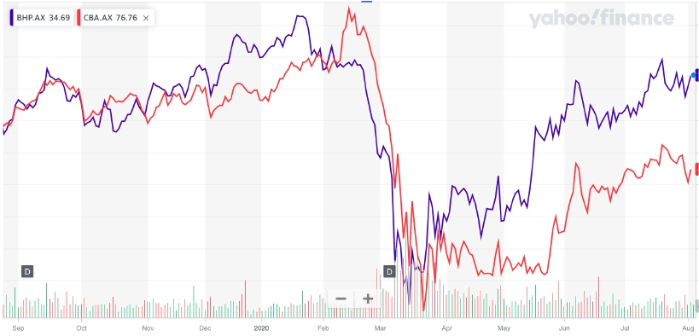
Background: Why factors?
• Example: Plot of share prices over the last year of BHP (= mining company) and
CBA (= bank).
• Different companies, in different industries, with different customers, and different
global exposure etc.
• Returns appear to be linked in some way, especially over some periods.
7

Slide 8
Background: Why factors?
• Factor argument:
• BHP and CBA are both exposed to the same underlying, non-industry-specific
factors.
• Instead of name/industry diversification, we should be more concerned with the
underlying factor exposure and factor diversification of our portfolio.
8

Slide 9
Factors and Factor Investing
• Soupé et al. (2019):
• “Factors are characteristics that explain… equity portfolio returns.”
• Briere and Szafarz (2016):
• “Factor investing emerged as the byproduct of factor models of asset
pricing.”
• Factor investing “consists in holding assets with positive exposure to
selected risk factors and, if possible, shorting those with negative
exposure.”
9

Slide 10
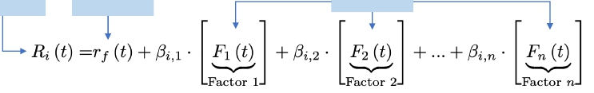

What is a factor model?
• Factor model: A model explaining returns of stocks as a function of multiple
factors.
• Linear factor models: Most popular.
• Combination of factors easily understood.
• Straightforward estimation using time series regression.
Return on stock i
Risk-free rate
Factor returns
• Nonlinear factor models:
• Nonlinear model (e.g. neural network) and/or complicated factors.
• Difficult to understand or explain factors and/or model implications.
E.g. neural network
Return on stock i
Feature vector
10

Slide 11
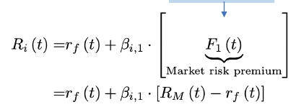
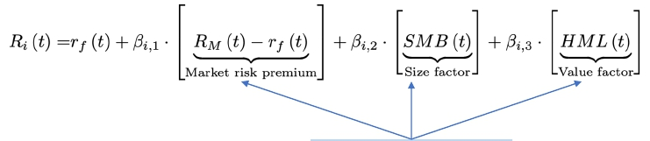
Some classical linear factor models
• CAPM (1-factor):
One factor = Market
• Fama/French 3 factor model (FF3):
• Size factor = SMB = Small minus Big:
• Value factor = HML = High minus Low:
Three factors: Market, Size, Value
11

Slide 12

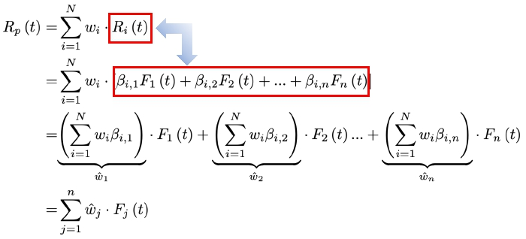
Asset allocation vs. factor allocation
• Suppose we have the following:
• 𝑛 factors in a linear factor model (zero risk-free rate).
Return on stock i
• 𝑁 stocks with returns 𝑅𝑖:𝑖 = 1,…,𝑁 .
• Form portfolio 𝑝 with asset allocation/weights 𝑤𝑖:𝑖 = 1,…,𝑁 .
• Portfolio return:
Linear factor model
12

Slide 13




Summary: Factor investing
• What is factor investing?
• Forming an equity portfolio by increasing or decreasing exposures to particular
investable factors.
• This (factor) equity portfolio is then combined with a bond portfolio to get the total
investment portfolio.
Factor investing:
How do we form this
factor portfolio?
Factor 1
Bond portfolio
Total portfolio
Investable factors simply
treated as “stocks” in
portfolio allocation
Factor 2
⋮
Factor n
Equityportfolio
• Why factor investing?
• Reduces equity portfolio allocation decision to only 𝒏 factors, instead of 𝑁 stocks, with
𝑛 ≪ 𝑁.
• Relatively easy to interpret the resulting allocation as an investment style (e.g. “value”
investing and “momentum/trend-following” strategy etc.)
• Arguably some theoretical justification for using factors, and by implication, for factor
investing.
13

Slide 14
Investable factors as “stocks”
• Is it reasonable for a retail investor to treat investable factors as “stocks”?
• Depends on what we mean by factors.
• Reminder:
• The term “factor” is used here to denote any portfolio formed to highlight a
particular characteristic of the underlying stocks.
• Distinguish two classes of factors:
1. Academic (long-short) factors: technical definition of the factor as used in a factor
model.
2. Long-only factors (“factor tilt”): How the conclusions of factor model theory
appear to be mostly used in practice.
14

Slide 15

Academic (long-short) factors
• Example: Size and Value factors in FF3 .
• FF sorts firms by “Value” and “Size” information, identify 6 groups of stocks.
Value = (Book value of equity) / (Market cap)
Min Value
Max Value
Min size
Size
(market cap)
30th percentile
70th percentile
SmallGrowth | SmallNeutral | SmallValue
BigGrowth | BigNeutral | BigValue
Median
Max size
• Form a market cap-weighted portfolio of each group.
• Construct long-short factors using returns of these portfolios:
SIZE
factor
SMB = 1/3 (Small Value + Small Neutral + Small Growth)
- 1/3 (Big Value + Big Neutral + Big Growth)
Value HML = 1/2 (Small Value + Big Value)
factor
- 1/2 (Small Growth + Big Growth)
15

Slide 16
Academic (long-short) factors
• From an academic factor model perspective, a factor needs to capture some “extra
dimension of risk”, unaccounted for by other factors. As a result, it is typically:
1.
2.
Long-short.
Zero beta with respect to other factors (including market factor).
• In practice, academic factors portfolios may be expensiveand/or difficult/impossible
to implement and maintain.
• Bender et al. (2013):
• “The original studies on factors were intended to identify which stock characteristics
explainedreturns.”
• “These studies were not concerned with whether those factors were actually investable.”
• “Specifically, the factor portfolios constructed by the academics in these studies were not
designed for actual implementation.”
• Novy-Marx and Velikov (2016):
• Show that “almost no factor, constructed as a long-short portfolio, with turnover exceeding
50% has any return left after accounting for transactions costs.”
• Arnott et al. (2017c):
• “We find slippage between the factor returns realized by mutual fund managers and the
theoretical factor returns earned by long-short paper portfolios”
• “The source of the slippage appears to be costs related to implementation…”
16

Slide 17
Academic (long-short) factors
• The good news: We can drop the “short” leg of the academic factors and still get
some benefit from factor investing.
• Israel and Moskowitz (2013):
• “Factor investing can work even with no short-selling.”
• Blitz et al. (2014) investigates whether “factor investing can best be
implemented using a long-only or a long-short approach.”
• “We show that implementation costs [transaction costs, borrowing costs, margin
requirements] … may completely offset the value added of a long-short
implementation.”
• Blitz et al. (2020a) examines “the long and short sides of Fama-French factor
portfolios and found that the added value of common factors is generally
concentrated in the long legs”.
• Also, “long legs offer more diversification than the short legs”
• “Short selling also entails additional risks, such as (1) the potential for unlimited
losses, (2) short squeeze scenarios…(3) counterparty risk, and (4) reputational risk.”
• Unfortunately, a lot of academic research ignore these issues, and still construct
long-short factor portfolios with some enthusiasm. (e.g. Lioui and Tarelli (2020))
17

Slide 18

Long-only factors (factor tilts)
• Cazalet and Roncalli (2014): “Most products [e.g. investable ETFs etc.] based on
risk factors generally use a long-only portfolio.”
• Use long-only “factors” (factor tilts) to gain exposure to the conclusions of
factor theory.
• Example: Some rough, informal implications of FF3:
1. small stocks tend to outperform large stocks.
2. value stocks tend to outperform growth (low value) stocks.
• To take advantage of this, sort firms by “Value” and “Size”:
Sort firms by: Value = (Book value of equity) / (Market cap)
Min Value
30th percentile
70th percentile
Max Value
Growth
Neutral
Value
Sort firms by:
Size = (Market cap)
Min Size
30th percentile
70th percentile
Max Size
Small
Medium
Large
• In our portfolio, we might assign relatively larger weights to “Value” stock index and
“Small” stock index.
• Factor tilts.
18

Slide 19
Long-only factors (factor tilts)
• A lot of recent research do recognize the fact that many investors are limited to
long-only, investable factor portfolios.
• Some recent examples:
• Ghayur et al. (2018) considers “long-only multifactor strategies…”
• Soupé et al. (2019):
• Construct a “long-only constrained portfolio that retains the targeted
exposures to four factors.”
• Du and Price (2018):
• “We focus on long-only investing because most mutual funds and ETFs are
long-only and individualinvestors may be more comfortable with long-only
portfolios.”
• Hjulgren (2018):
• “Despite these drawbacks, factor ETFs have offered higher returns and Sharpe
ratios than their respective long-short counterparts, which gives support for
the long-only approach to factor investing.”
• Hansen and Bonne-Kristiansen (2020):
• “Both the implementability and profitability of the strategies investigated by
this thesis are immensely impacted by the type and size of the investor.”
• Feng and He (2020) explicitly considers long-only factor investing.
• “We optimize the mean-variance utility and update portfolio weights every
month, with constraints of long-only and no leverage.”
19

Slide 20
Beware of the Transaction Costs
• We distinguish between 2 types of transaction costs:
• Implicit transaction costs: Market impact of large factor ETFs rebalancing.
• Explicit transaction costs: Direct cost of trading, e.g. proportional transaction costs.
• Focusing on explicit transaction costs, something to keep in mind when reading
about fantastic long-only or long-short factor investing results in the literature:
• Cerniglia and Fabozzi (2018):
• “Many studies on [factor investing] ignore the costs associated with trading, thereby
overstating the returns these strategies achieve.”
• Li and Shim (2019):
• “In this study, we highlight the trade-off between gaining excess returns associated
with factors and the impact of implementation costs in constructing a multi-factor
[factor investing] strategy.”
• Dichtl et al. (2019):
• Find that “active [long-only] factor allocation outperforms the 1/N benchmark by
only seven basis points after transaction costs with the net return erosion
stemming from excessive trading frequency as warned as a potential pitfall by
various sceptics.”
20

Slide 21
Overview of talk
✓ Reminder: Beating the market (long-term, consistently) is hard.
✓ Factors and factor investing. Long-short vs. long-only.
✓ Beware of the transaction costs.
❑
❑
❑
❑ Identifying factors. Data mining (p-hacking).
❑ Constructing factor models. Model mining.
❑ Machine learning (ML) is not helping, despite the hype.
❑ Factor timing. Predicting the future, and all that.
❑ Factor performance: Past is not prologue.
❑ How to profit reliably from factor investing.
❑ Reminder: Beating the market is hard.
21

Slide 22
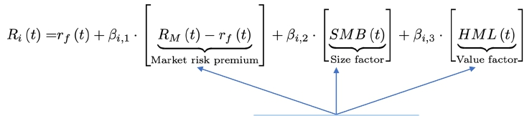
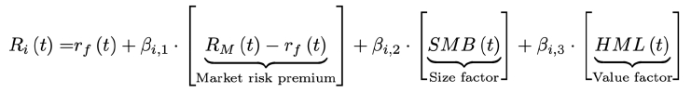
Explaining factor models
• Consider the Fama/French 3 factor model (FF3):
Three factors: Market, Size, Value
• The intercept (risk-free rate) and market risk premium makes intuitive sense:
• But why two additional factors?
• And why should the two additional factors be Size and Value, specifically?
✓
✓
?
?
22

Slide 23



Some thoughts on explanations
• Suppose I make the following claim:
“When the stock market crashes, (US) Treasury bonds do well.”
• How would you go about explaining this claim?
• Argument group 1: Institutional mandates and the resulting actions, policies.
Example: US Fed actions relating to interest rates, market stability, liquidity, etc.
• Argument group 2: Behavioral and/or economic arguments.
Example: “flight to quality”, “increased risk aversion”, “safe havens”
• Argument group 3: Purely empirical observations.
Example: “Look at the history, it just always works out that way.”
23

Slide 24


Factors: Non-explanations vs. explanations
• Suppose I make the following claim [basically interpreted as “investment advice” by
normal people, despite all those disclaimers]:
Example: “There is such a thing as the size premium: Small stocks tend to
outperform large stocks.”
• How would you go about explaining thisclaim?
• Argument group 1: Institutional mandates and the resulting actions, policies.
• Missing when it comes to factors!
• Some people have tried, but arguing vaguely about incentives of pension funds is
just awkward.
• Argument group 2: Behavioral and/or economic arguments.
• Also mostly missing when it comes to factors!
• It is too easy to come up with some semi-plausible, realistic sounding explanations
[hint: use big words, include the word “rational” at least once], but how sound are
these arguments, actually? How much of it is fancy hand-waving?
• Some exceptions: E.g. “momentum” and “irrational exuberance”.
• Argument group 3: Purely empirical observations.
• We are down to this: “Look at the history,it seems to work out that way over long
periods. Just look at the t-statistics!”
• But this ignores the problem of widespread data mining / p-hacking.
24

Slide 25
Factors: Non-explanations vs. explanations
• Fischer Black (1992):
• “Fama and French… give no reasons for a relation between size and expected
return.”
• “…I think it is quite possible that even the book-to-market [value] effect results from
data mining, and will vanish in the future.”
• “Lack of theory is a tipoff: watch out for data mining!”
• Lioui and Poncet (2011):
• “These factors [Size and Value], however, are based on purely empirical
considerations, lack theoretical underpinnings, and are built in a rather arbitrary
manner.”
• “In particular, their economic links to systematic risk are not clear.”
• “The alleged ability of innovations in predictors to explain the cross section of
expected excess returns is rather illusory.”
• Arnott et al. (2019):
• “We detail the impact of data mining on both factor selection and disappointing
out-of-sample factor performance.”
• Also, nobody cares. As Taylor Swift (2014) pointed out, though not in the
context of factor investing, “…the haters gonna hate, hate, hate, hate, hate.”
25

Slide 26
Identifying factors
• It really is the discovery of the Goose that Laid the Golden Eggs:
• Lots and lots of factors have been identified (>400).
• Think of all the papers, PhDs, postdoc jobs, etc.
• Cochrane (2011) first coined the term “zoo of new factors”.
• Everybody calls it a “factor zoo” these days.
• Harvey and Liu (2020):
• “The finance profession has been on a 50-year quest to identify factors that explain the
cross- section of expected returns.”
• “However, even after all this time, there is no consensus as to what the factor structure
looks like.”
• Hsu et al. (2015):
• “In our view, a robust factor is, first, one whose economic underpinnings and persistence
have been debated and validated in numerous research papers”
• So about those “numerous research papers” that “debated” and “validated” the
“economic underpinnings” etc. of the factors:
• Things have not … shall we say … gone well.
26

Slide 27
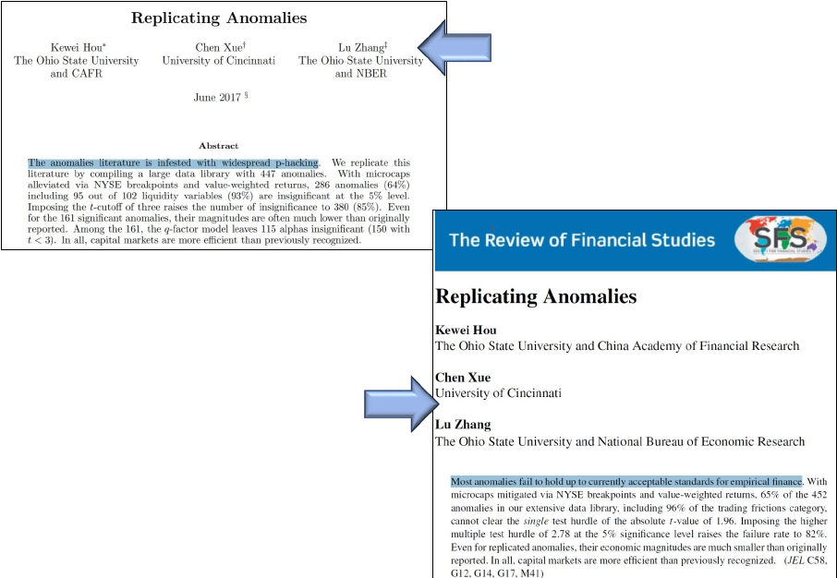
Identifying factors
Hou et al. (2020): [working paper]
“The [factor] literature is infested with
widespread p-hacking.”
Hou et al. (2020): [published version]
“Most [factors] fail to hold up to currently
acceptable standards for empirical finance.”
27

Slide 28
Identifying factors
• Harvey et al. (2016):
• Test 316 factors that claim to explain the cross-section of expected returns.
• “Given the plethora of factors, and the inevitable data mining, many of the
historically discovered factors would be deemed ‘significant’ by chance.”
• “We argue that most claimed research findings in financialeconomics are likely
false.”
• “Many of these factors that our method deems statistically true have tiny Sharpe
ratios.”
• Hou et al. (2020):
• “Most [of the 452 factors tested] fail to hold up to currently acceptable standards for
empirical finance.”
• “Even for replicated [factors], their economic magnitudes are much smaller than
originally reported.”
• Feng et al. (2020):
• “Our factor library contains 99 risk factors.”
• “Many factors introduced in the last few years appear entirely redundant and
contain no new useful information for pricing the cross section of returns.”
28

Slide 29
Which factor model?
• It isn’t just individual factors…what about factor models? I.e. what combination
of factors should we prefer?
• Some famous examples:
•
•
•
•
Fama and French (1992): 3 factor model
Carhart (1997): 4 factor model
Fama and French (2015): 5 factor model
MSCI Barra factor model (>=1996): >40 factors
• Harvey and Liu (2020):
• “it is hard to interpret the literature when:
• “one set of authors presents evidence in favor of their five-factor model with
one set of portfolios and”
• “another set of authors presents evidence in favor of their five-factor model
based on a different set of portfolios.”
29

Slide 30




Which factor model?
• Kogan and Tian (2015): empirical investigation of “model-mining”:
• “How should we evaluate proposed factor pricing models with strong pricing
performance but without sound theoretical motivation?”
• “We quantify just how easy it is to generate seemingly successful empirical c-factor
models.” [c = number of factors]
Step 1: 27 firm characteristics [factors]
Step 2: Randomly select X number of factors
proposed in the literature as predictive
variables for stock returns
Step 3: Fit a (X+1)-factor linear factor model
Step 4: Evaluateperformance of random factor model
“The bottom line is that over the 1971-2011 sample period,many
randomly constructed empirical three-factor models comfortably
‘outperform’ both the CAPM and the Fama-French model.”
30

Slide 31

ML: Model/data mining
• Machine learning (ML): What about recent rise in non-linear factor models?
E.g. neural network
X = Factors (feature vector)
• ML papers, for the most part, have embraced data mining, often with an
unabashed enthusiasm.
• In financial economics, there’s often at least an attempt at trying to come up with an
economic rationale for factors.
• But what about that fantastic out-of-sample ML portfolio performance?
• Large number of features considered.
• If a feature works well “in-sample” but not “out-of-sample”, it is dropped: “overfitting”.
We may never know about it!
• It’s not news if the weather in Waterloo fails to predict the stock market.
• If a feature works well “in-sample” and “out-of-sample”, it is retained: “excellent
predictor”.
• So what’s the problem?
• Harvey and Liu (2020), referring to factor models generally: “given the large
number of candidate factors, some could just be lucky.”
• In fact, I would say some are all but guaranteed to be lucky.
31

Slide 32
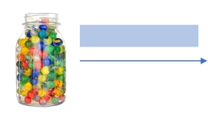

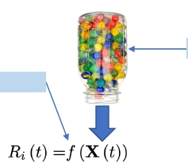
ML: Model/data mining
• Recall Kogan and Tian (2015): With linear factor models, randomly selected
factor models can easily outperform the classical factor models:
E.g. randomlypick 2
“The bottom line is that over the 1971-2011 sample period,many
randomly constructed empirical three-factor models comfortably
‘outperform’ both the CAPM and the Fama-French model.”
• The ML approach is basically using (i) a highly non-linear model (NN) of (ii) ALL
the factors one can think of….
• Comparing this result with classical linear factor models.
• And then be very pleased if it outperforms the linear, classical factor models.
X = Factors (feature vector)
E.g. neural network
32

Slide 33
ML factor models
• Gu et al. (2020): [NN]
• “We conduct a large-scale empirical analysis, investigating nearly 30,000 individual
stocks over 60 years from 1957 to 2016.”
• “Our predictor set includes 94 characteristics for each stock, interactions of each
characteristic with 8 aggregate time-series variables, and 74 industry sector dummy
variables.”
• “Some of our methods expand this predictor set much further by including
nonlinear transformations and interactions of the baseline signals.”
• Alberg and Lipton (2018): [NN]
• “The final list contains 11,815 stocks.”
• “For each stock and at each time step t, we consider a total of 20 input features.”
• 16 features based on financial statement info, 4 stock price “momentum features”.
• Chen et al. (2019): [NN]
• Considers macroeconomic indicators as features in an asset pricing model.
• “We collect 178 macroeconomic time series from three sources.”
• “Our recurrent Long-Short-Term-Memory network finds a small set of hidden
economic state processes.”
33

Slide 34
ML factor models
• Cong et al (2020): The “AlphaPortfolio” paper.
• From the paper: “The resulting AlphaPortfolio yields stellar out-of-sample
performances even after imposing various economic and trading restrictions.”
• It’s not pitched as a “factor model”, but on some level, it basically is one.
• “Importantly, we use polynomial-feature-sensitivity and textual-factor
analysesto …[do amazing things]. Such ‘economic distillations’ reveal key
market signals, firms’ financials…that drive investment performance.”
• So which factor (feature) is most prominent in delivering this “stellar out-of-
sample” performance?
• Inventory change, or IVC: which shows up twice(!) as IVC and (IVC^2) in the list
of the 15 “most dominant features”.
• IVC = “change in inventories over the average total assets of t and (t-1)”:
𝐼𝑉𝐶𝑡 = 2 × 𝐼𝑛𝑣𝑡 − 𝐼𝑛𝑣𝑡−1 / 𝐴𝑠𝑠𝑒𝑡𝑠𝑡 + 𝐴𝑠𝑠𝑒𝑡𝑠𝑡−1
• Is this ratio really a robust predictor of investment performance?
• What is the IVC of Facebook or Google or Moderna or Zoom?
• Is higher IVC better? Is smaller IVC better? Sensitivity of this ratio?
• In the 61 pages(!) of the AlphaPortfolio paper, the central role of this ratio (and
ratio^2) in achieving “stellar” performance raises no concerns.
34

Slide 35
ML factor models
• I’m not saying IVC contains no information.
• But if IVC is the dominant driver of “stellar” predictive performance, I have questions
[given the background of data mining and factors], and it would be nice to see some
attempted answers.
• To their credit, Cong et al (2020) does try to figure out which features explain
the resulting portfolio allocation decisions.
• That is the reason why I know that IVC (and IVC^2) is so prominent.
• The most common scenario in ML literature is that authors don’t care which
features are the most prominent in asset allocation decisions.
• (or at best there is some rudimentary “sensitivity analysis” or something.)
• When it comes to factor investing, ML is not helping with the widespread data
mining / model mining problem.
• ML just gives everybody the permission not to feel guilty about doing it.
35

Slide 36
Factors in practice: A matter of convention
• So which factors should we consider as the “true factors”?
• In the literature, the selection of candidate factors for factor investing purposes is
basically a matter of convention:
• Some factors are just commonly accepted as factors: Size, Value, LowVol, Momentum,
and maybe a handful of ill-defined others, like Quality and “Multi-factor”.
• Whether or not the original “discovery” of a factor suggests it is the result of data
mining or not, nobody cares. Conventions rule.
• Examples:
• Melas (2016): “Factors are well documented in academic finance research. The most
important equity factors include value, size, momentum, volatility, quality, and yield.”
• HSBC (2015): “…it is essential to focus only on factors that are strongly supported by
empirical evidence with solid economic justifications. From this perspective the value,
size, momentum, low volatility and quality factors seem a natural choice.”
• Blitz (2017) : “...established factors such as size, value, momentum, and low volatility”
• Fitzgibbons et al. (2017): “We focus on value and momentum, two well-known styles”
• Briere and Szafarz (2017): “Working with classic factors (size, value, and momentum) is
an advantage, since the literature is consensual about their relevance”
• Li and Shim (2019): “Some of the most commonly used factors in investor portfolios
are value, momentum, quality, low risk, and size…”
• Blitz et al. (2020a): “Evidence for the existence of various factor premiums in the
equity market, such as the value, momentum, and low-risk premiums - is abundant.”
36

Slide 37
Overview of talk
✓ Reminder: Beating the market (long-term, consistently) is hard.
✓ Factors and factor investing. Long-short vs. long-only.
✓ Beware of the transaction costs.
❑
❑
❑
✓ Identifying factors. Data mining (p-hacking).
✓ Constructing factor models. Model mining.
❑
❑
✓ Machine learning (ML) is not helping, despite the hype.
❑
❑ Factor timing. Predicting the future, and all that.
❑ Factor performance: Past is not prologue.
❑ How to profit reliably from factor investing.
❑ Reminder: Beating the market is hard.
37

Slide 38

Factor timing
• Finally, we get down to the business of predicting the future.
• “When, clutching our crystals and nervously consulting our horoscopes, our
critical faculties in decline, unable to distinguish between what feels good and
what's true, we slide, almost without noticing, back into superstition and
darkness...”
- Carl Sagan, The Demon-Haunted World: Science as a Candle in the Dark.
• So let’s slide into superstition and darkness...
38

Slide 39
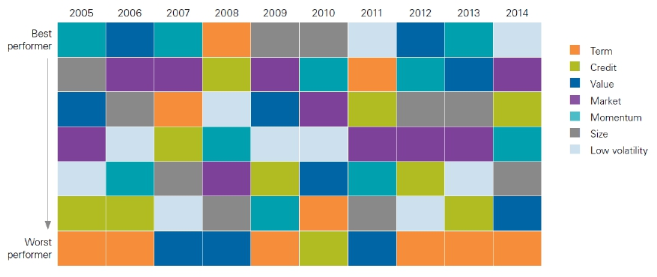
Factor timing
• Vanguard Research (2015):
• Ranking of annual returns of selected long-only factor portfolios over 10 years
Size
Size
Size
Size
Size
Size
Size
Size
Size
Size
• Factor timing: Can we somehow predict which factors are going to perform
well/not so well, next?
• Example, Size : Can we use information from, say, 2005-2008 to predict its great
performance in 2009-2010?
39

Slide 40
Factor timing
• Informal observation:
• There seems to be a practitioner/academic split in factor timing literature.
• “Practitioners” = authors affiliated with the wealth management industry.
• “Academics” = authors with university affiliations.
• In summary:
• “Practitioners” are very, very suspicious about factor timing.
• “Academics” are very excited and report *amazing* findings:
• For some reason, instead of quietly making a fortune, these academic results
are inexplicably published in random journals.
• Before giving examples, a couple of things should be noted.
40

Slide 41
Factor timing: General comments
• Asness (2016):
• “There is powerful incentive to oversell timing ability.”
• “Factor timing has the potential of reintroducing a type of skill-based active
management (as timing is generally thought of this way) back into the equation.”
• My translation: If you can convince people of your crystal ball’s predictions, they’ll
pay you good money for it.
41

Slide 42
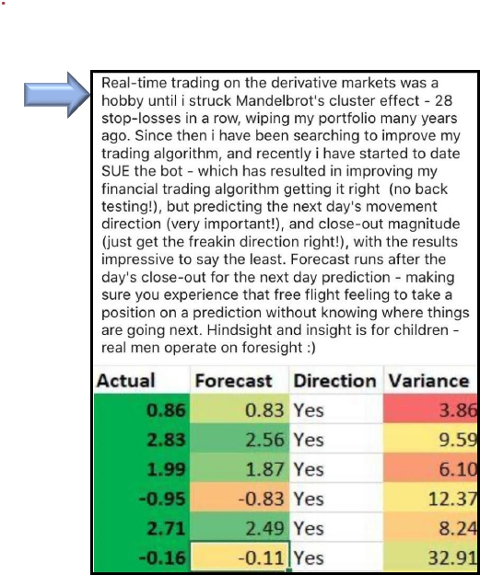
Factor timing: General comments
Spam email
• Spam email that I recently received
• The email contains some “interesting”
statements:
• “i struck Mandelbrot’s cluster effect – 28
stop losses in a row, wiping my portfolio”
• “But predicting the next day’s movement
direction (very important!)”
• “i have been searching to improve my
trading algorithm”
• “…getting it right (no back testing!)”
• “Hindsight and insight is for children –
real men operate on foresight :)”
• Remember the incentive to oversell
timing ability: This nonsense doesn’t
have to convince a lot of people: just
enough people.
42

Slide 43
Factor timing: General comments
• Bender et al. (2018):
• It is really important to ask: “What should the relationship between the candidate
signals and future factor returns look like?”
• “Without strong investment rationale, there is too much danger that data mining
can drive the choice of signals.”
43

Slide 44
Factor timing: “Practitioner” view
• Asness (2016):
• “Factor timing is highly analogous to timing the stock market.”
• “Stock market timing is difficult and should be done in very small doses, if at all.”
• Arnott et al. (2016a):
• “Most investors already practice a form of market timing by performance chasing,
which can erode the benefits of factor investing even when diversifying across
factors having recent strong results.”
• Asness et al. (2017):
• “We know that contrarian market timing is very difficult, and we find that successful
contrarian timing of [factors] is at least as difficult.”
• “From a multi-style perspective, it is hard for contrarian style timing to meaningfully
improve upon simple strategic diversification.”
• Lee (2017):
• “The author believes that attempting to time factors using other factors is generally
of limited value…”
• “Factor timers would be better served by focusing on the underlying rationale
believed to give rise to these premia.”
44

Slide 45
Factor timing: “Practitioner” view
• Dichtl et al. (2019):
• “When ignoring transactions costs, the authors report significant excess returns to..
the factor timing… strategies, but consent that active factor-forecasting adds little
value after transaction costs in their model specification.”
• Van Gelderen et al. (2019):
• “We argue that rather than timing factors and factor managers, investors would be
better off by using a buy-and-hold strategy and selecting a multifactor manager.”
45

Slide 46
Factor timing: “Academic” view
• Haddad et al. (2020):
• “Market-neutral equity factors [long-short factors] are strongly and robustly
predictable.”
• “Exploiting this predictability leads to substantial improvement in portfolio
performance relative to static factor investing.”
• Lioui and Tarelli (2020):
• “We implement a dynamic allocation problem where the investor attempts to time
[long-short factor] portfolios.”
• They basically take the long-short portfolios from FF, and then vary the weights:
SIZE
factor
Value
factor
SMB =
HML =
1/3 (Small Value + Small Neutral + Small Growth)
- 1/3 (Big Value + Big Neutral + Big Growth)
1/2 (Small Value + Big Value)
- 1/2 (Small Growth + Big Growth)
• “We employ two variables (dividend yield and default spread) to predict the
conditional expected abnormal returns and market exposures of the assets”
• “Significant out-of-sample Sharpe ratio improvements and utility gains with respect
to fixed-weights factor benchmarks.”
46

Slide 47

Factor timing: “Academic” view
• Laborda et al. (2016):
• They predict the Fama and French Size (SMB) factor, with great success.
SIZE
factor
SMB =
1/3 (Small Value + Small Neutral + Small Growth)
- 1/3 (Big Value + Big Neutral + Big Growth)
• Predictor variables include: “interest rates”, “overall credit conditions”, “market risk
aversion”, “economic sentiment”.
• “These variables and the inclusion of a risk-free asset in the investment opportunity
set allow us to derive an optimal investment portfolio given by a long position on the
size factor in periods of economic expansion and a short position in periods of
economic downturn and financialturbulence that is compensated by a long position
in the risk-free asset.”
• “Thus, we observe that an investor who follows optimized dynamic size factor
strategies attains a higher Sharpe ratio.”
• Thoughts on the [academic] success of long-short factor timing:
• Given what we know of long-short factors, transaction costs, investability etc…
• If you design a winning Monopoly strategy… does that make you a successful real
estate investor?
47

Slide 48
Factor timing
• Some general questions, for which I’ve never seen nice answers.
• Question 1: If factor timing “works”, compared to what does it “work”?
• Typically, factor timing “works” if investment results from [Model with factor timing
predictions] outperforms the investment results from [benchmark].
• Unfortunately, in the literature, [benchmark] is typically something uninspiring, like
an [equally-weighted factor portfolio].
• But [equally-weighted factor portfolio] tends to perform pretty badly.
• Outperforming [benchmark] with terrible performance isn’t *that* hard, as long as it
isn’t the market!
• You can outperform an [equally-weighted factor portfolio] by dropping
exposure to Size. You’re welcome. ☺
• Question 2: Why is timing equity factors, specifically, the source of so much
excitement?
• If you’re good at the “timing thing”, why not time something better – namely the
aggregate stocks vs. bond allocations in your portfolio?
48

Slide 49
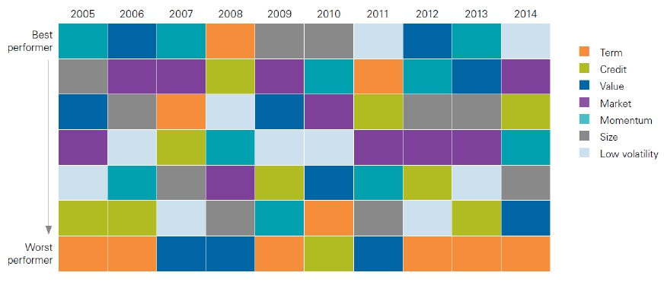
Factor timing
• Question 1: If factor timing “works”, compared to what does it “work”?
• Vanguard Research (2015): Ranking of annual returns of selected long-only factor
portfolios
•
V
V
M
M
M
V
V
M
M
V
M
M
M
M
M
V
V
V
V
V
• Relative frequency of ranking:
• M = Market.
Best
Worst
Rank/7:1234567
Freq /10 | Market | 40%10%40%10%
 | Value | 20%10%20%10%10%30%
• V = Value.
• Factor timing has a very high bar to clear, namely passively holding market!!
• Getting factor timing wrong can result in really, really bad outcomes!!
49

Slide 50
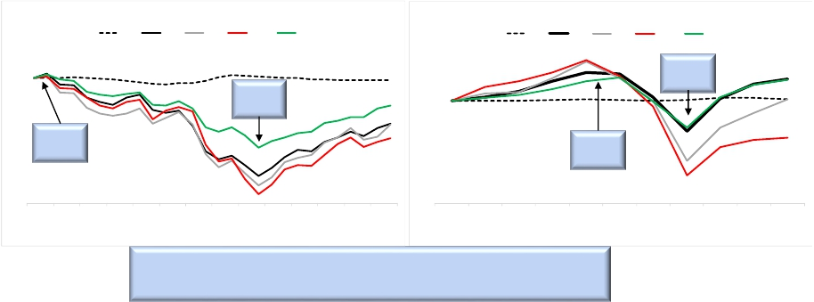
Factor timing: the wrong question?
• Question 2: Why is timing equity factors, specifically, the source of so much
excitement?
• If you’re good at the “timing thing”, why not time something better – namely the
aggregate stocks vs. bond allocations in your portfolio?
• Example: GFC and Covid crash:
• Arnott et al. (2019): “In periods of market stress, however, most diversification
benefits can vanish as the factors begin moving in unison…”
• If factors begin to move in unison.. what is the marginal benefit of “timing factors”
when we most need it?
Investing $100 in each index at the end of Sep 2007
Investing $100 in each inflation-adjusted index at end of Aug 2019
T30
Mkt
Size
Value
Vol
T30
Mkt
Size
Value
Vol
115
120
105
95
85
75
65
55
45
35
Sell all
bonds
110
100
90
80
70
60
Sell all
bonds
Sell all
stocks
Sell all
stocks
Sep-07
Nov-07
Jan-08
Mar-08
May-08
Jul-08
Sep-08
Nov-08
Jan-09
Mar-09
May-09
Jul-09
Sep-09
Nov-09
Aug-19
Sep-19
Oct-19
Nov-19
Dec-19
Jan-20
Feb-20
Mar-20
Apr-20
May-20
Jun-20
Why care about which factor is going to do well next, if you
can move out of stocks into bonds at the right time?
50

Slide 51
Overview of talk
✓ Reminder: Beating the market (long-term, consistently) is hard.
✓ Factors and factor investing. Long-short vs. long-only.
✓ Beware of the transaction costs.
❑
❑
❑
✓ Identifying factors. Data mining (p-hacking).
✓ Constructing factor models. Model mining.
❑
❑
✓ Machine learning (ML) is not helping, despite the hype.
✓ Factor timing. Predicting the future, and all that.
❑
❑
❑ Factor performance: Past is not prologue.
❑ How to profit reliably from factor investing.
❑ Reminder: Beating the market is hard.
51

Slide 52
Factor performance: Past is (not) prologue
• Malkiel (2014):
• “All [factor] portfolios have undergone long periods of underperformance.”
• “There is considerable evidence of reversion to the mean, and periods of excess
performance are often followed by periods of disappointing results.”
• Arnott et al. (2016a):
• “We use a simple rule to show that trend chasing destroys value. Whatever is newly
expensive is likely to have two attributes: wonderful past returns and disappointing
future returns.”
• Arnott et al. (2016b):
• “Many investors are performance chasers who in pushing prices higher create
valuation levels that inflate past performance, reduce potential future performance,
and amplify the risk of mean reversion to historical valuation norms”
• Arnott et al. (2017a):
• “Using past performance to forecast future performance is likely to disappoint.”
• “We find that a factor's most recent five-year performance is negatively correlated
with its subsequent five-year performance.”
• “By significantly extending the period of past performance used to forecast future
performance, we can improve predictive ability, but the forecasts are still negatively
correlated with subsequent performance.”
• “The forecast is still essentially useless!”
• Arnott et al. (2019):
• “We also believe that shaping our forward expectationsby extrapolating … past
results… is very dangerous.”
52

Slide 53
Factor performance: Word gets out…
• Mclean and Pontiff (2016):
•
•
•
•
•
Analyzes out-of-sample and post-publication performance of 97 factors.
Returns are 26% lower out-of-sample.
Returns are 58% lower post-publication.
“Post-publication declines are greater for predictors with higher in-sample returns.”
“Our findings suggest that investors learn about mispricing from academic
publications.”
• Arnott et al. (2016b):
• “Many of the most popular new factors and strategies have succeeded solely
because they have become more and more expensive.”
• “Factor returns, net of changes in valuation levels, are much lower than recent
performance suggests.”
• Arnott, Kalesnik and Wu (2017):
• “Yet, we must wonder, if 10,000 quants are all pursuing the same factor tilts, how
likely are they to add value?”
53

Slide 54
Overview of talk
✓ Reminder: Beating the market (long-term, consistently) is hard.
✓ Factors and factor investing. Long-short vs. long-only.
✓ Beware of the transaction costs.
❑
❑
❑
✓ Identifying factors. Data mining (p-hacking).
✓ Constructing factor models. Model mining.
❑
❑
✓ Machine learning (ML) is not helping, despite the hype.
✓ Factor timing. Predicting the future, and all that.
✓ Factor performance: Past is not prologue.
❑
❑
❑
❑ How to profit reliably from factor investing.
❑ Reminder: Beating the market is hard.
54

Slide 55
Profiting reliably from factor investing
• Case study #1: iShares/Blackrock
• “iShares Core S&P U.S. Value ETF” [IUSV]:
• Launch date:July 2000
• Objective: “…seeks to track the investment results of an index composed of large- and mid-
capitalization U.S. equities that exhibit value characteristics.”
• Grossexpenseratio: 0.04%
• YTD 2020 performance (1 Jan-26 Nov): - 3.06%
• “iShares MSCI USA Value Factor ETF” [VLUE]:
• Launch date:April 2013
• Objective: “…seeks to track the performance of an index that measures the performance of U.S.
large- and mid-capitalization stocks with value characteristics…”
• Grossexpenseratio: 0.15%
• YTD 2020 performance (1 Jan-26 Nov): - 4.41%
• “iShares Focused Value Factor ETF” [FOVL]:
• Launch date:April 2019
• Objective: “…seeks to track the investment results of an index composed of U.S. large- and mid-
capitalization stocks with prominent value characteristics.”
• Grossexpenseratio: 0.25%
• YTD 2020 performance (1 Jan-26 Nov): - 19.91%
55

Slide 56
Profiting reliably from factor investing
• Case study #2: Vanguard
• “Vanguard Value ETF” [VTV]:
• Launch date:February 2004
• Objective: “…seeks to track the performance of the CRSP US Large Cap Value Index, which
measures the investment return of large-capitalization value stocks.”
• Grossexpenseratio: 0.04%
• YTD 2020 performance (1 Jan-26 Nov): - 3.10%
• “Vanguard U.S. Value Factor ETF” [VFVA]:
• Launch date:March 2018
• Objective: “… investing in stocks with relatively lower share prices relative to fundamental
values as determined by the advisor.”
• Grossexpenseratio: 0.14%
• YTD 2020 performance (1 Jan-26 Nov): - 3.10%
• YTD 2020 performance of the S&P 500 (1 Jan – 26 Nov): + 12.35%
56

Slide 57

Profiting reliably from factor investing
• I’m not picking on ETF issuers here:
• They’re simply convenient to use as examples.
• Information is publicly available.
• Bloomberg News (18 November 2020): “Renaissance, Two Sigma Drop as
Quants Navigate Chaos”
• “Two of the hedge fund industry’s quantitative powerhouses are getting tripped up
this year as wild markets throw off their investing models.”
• “Two Sigma saw its risk-premia strategy lose 11.5% this year through last month
[October 2020], according to documents seen by Bloomberg. ”
• “For quantitative funds that specialize in so-called factor-investing… November
[2020] may have added to the bruising.”
• “Even for a firm such as AQR Capital Management, which was tilted toward value
stocks in some of its portfolios, the pullback from momentum exposure was too big
to overcome. The shift added to losses for the AQR Equity Market Neutral Fund,
which was down 19% this year through Monday.”
• At the risk of sounding cynical: I do think that monetizing the hype around factor
investing (by charging high fees) is the way to profit most reliably, for the time
being, from factor investing.
57

Slide 58

I’m not dismissing factor investing
• Arnott et al. (2019):
• “It is no secret that factor returns have recently fallen far short of investor
expectations.”
• “..we are not dismissing factor investing.”
• “We believe that the factor literature is rich with insights, many of which can be
used to deliver superior returns.”
• For the record, my view on factor investing:
• I also believe that “factor literature is rich with insights, many of which can be used
to deliver superior returns.”
• How should you go about delivering superior returns?
58

Slide 59
Bottom line: You’re on your own
• Bender et al. (2013):
• “Investors must form their own belief about what explains the historical premium
and whether it is likely to persist.”
• Melas (2016):
• “Investors making allocations to factors must form their own beliefs about what
explains factor returns and whether they are likely to persist.”
• Asness (2016):
• “Focus mostly on the factors you believe in over the very long haul, based on both
evidence and economic theory.”
59

Slide 60
Reminder: Beating the market is hard
• Cochrane (1999):
• “I emphasize a cautionary fact: The average investor must hold the market.”
• “You should only vary from a passive market index if you are different from
everyone else.”
• “It cannot be the case that every investor should tilt his portfolio toward value or
other high-yield strategies. If everybody did it, the phenomenon would disappear.”
• Melas (2016):
• “In reality, market-cap benchmarks are extremely difficult to outperform
consistently.”
• White and Haghani (2020):
• “For factors with plausible risk-based explanations, the authors conclude that even in
the presence of significant factor premia, the market portfolio is still likely to be
optimal for most investors.”
• Nes (2020): Analyzing factor investing ETFs over Jan-2007 and Mar-2020.
• “This thesis does not find any statistically significant evidence of [factor] ETFs
outperforming … broad, cap-weighted market indices.”
60

Slide 61
Questions?
61

